Slide 1
Wellwise: Advanced Nutrition Monitoring system
Project Guide:
Ms. Jyothi V Prasad
Assistant Professor
Dept. of CSE
MITE,
Mangalore
Team MEMBERS:
KRISHNARAJ S – 4MT20CS088
PRASHANTH D - 4MT20CS117
PRASIDDHI NAYAK – 4MT20CS118
SATHWIK RAO K - 4MT20CS142

Slide 2
Table of Contents
01. Introduction
02. Problem Statement
03. Objective
04. Methodology
05. Work Carried Out
06. Workflow
07. Outcome
08. Future Scope
09. References

Slide 3
Introduction
Living in this fast-paced era, the daily intake of high-caloric foods may seem harmless but conceals a perilous trap leading to conditions such as diabetes, obesity, and high blood pressure. With an increasing reliance on technology, people are turning to Food Tracker Apps to manage their diet. However, the burden of manual data entry has become a significant drawback, causing many to abandon these apps over time.
Our project proposes an innovative solution to this challenge. By harnessing deep learning algorithms, sophisticated computer programs that can learn and analyze, we aim to simplify the process. Users can now capture images of their meals, allowing the algorithms to identify the food items and predict their nutritional content approximately. This approach eliminates the time-consuming manual entry, making it more convenient and encouraging users to maintain healthier eating habits. Our vision is to leverage technology to enhance well-being, ensuring that managing nutrition is not only effective but also easily understandable.

Slide 4
Problem Statement
The multitude of diseases in today's society is largely attributed to lifestyle choices, particularly in the realms of food consumption. The prevalence of high-calorie diets contributes significantly to health issues like diabetes and obesity. The effectiveness of our current dietary choices and proportions demands scrutiny for optimal well-being. Amidst our fast-paced lives, adhering to healthy lifestyles becomes challenging, leading to difficulties in monitoring nutrition and water intake. There is a pressing need for innovative solutions to encourage healthier choices and simplify the process of maintaining adequate nutrition and hydration. As our schedules become busier, striking a balance in these fundamental aspects of health is increasingly elusive, necessitating interventions that align with our hectic daily routines

Slide 5
Objective
To create a comprehensive system for tracking food and nutrition consumption while providing healthy suggestions.
Building a diverse food image dataset, standardize formats through preprocessing, and enforce quality control measures.
By exploring feature extraction techniques like convolutional neural networks (CNNs),develop a rank-based ensemble to accurately predict and categorize various food items.

Slide 6
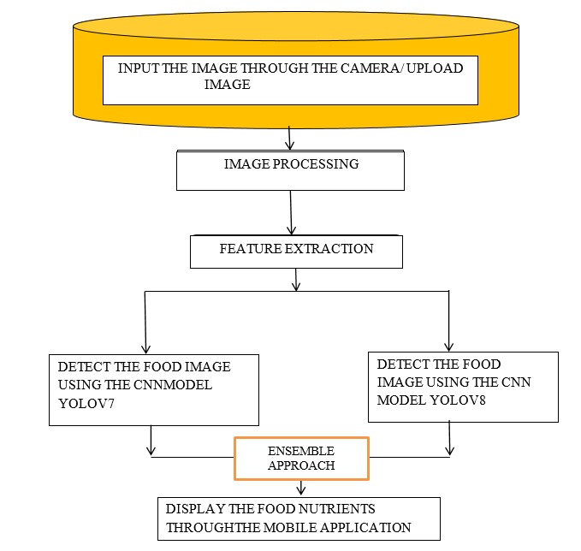
Methodology

Slide 7
Cont..
The approach would involve preprocessing food images to a standardized size and normalizing the values. These processed images are then fed into both YOLOv7 and YOLOv8 models, which are state-of-the-art object detection models known for their efficiency and accuracy.
Both YOLOv7 and YOLOv8 models utilize deep convolutional neural networks to extract features from the food images.
These features are then used to detect and classify various food items present in the images.
After obtaining detection results from both YOLOv7 and YOLOv8 models, the decision scores for each detected food item are calculated.
The decision scores from both YOLOv7 and YOLOv8 models are fused and the fusion process assigns weights to the decision scores based on the confidence scores of each model.
The weighted decision scores from YOLOv7 and YOLOv8 models, along with the weights generated by the fusion function, are combined to obtain the final ensemble value.
This ensemble value serves as the basis for determining the presence and category of food items in the input image

Slide 8
Work Carried Out
Trained Two Models: We trained two deep learning models- YOLOv7 and YOLOv8. The training was done on a labelled dataset (6800) of food images.
Tested the Models: Once the model were trained, we tested them using a separate test dataset to measure their accuracy(1000). The team selected the best performing model based on the accuracy(confusion) metrics.
Function Implementation: After selecting the best-performing model, the team implemented a function that takes an input image and returns the nutritional value of the food based on model prediction. The function uses the best-performing model selected in the previous step using ensemble approach.

Slide 9
Cont..
Testing the Function: To test the functions accuracy, we used a test dataset consisting of food images. For each test set, we acquired a confusion matrix and used ROC curves to predict accuracy.
Comparison with single model confusion matrix: We compared the confusion matrices obtained from the function implementation with the confusion matrices obtained from the individual models and checked how well our function predicted.
Implementation as a mobile application: Finally, we implemented the function as a mobile application using Flutter, a popular framework of Dart. The mobile application allows users to upload food images and receive name and the nutritional value of that food.

Slide 10
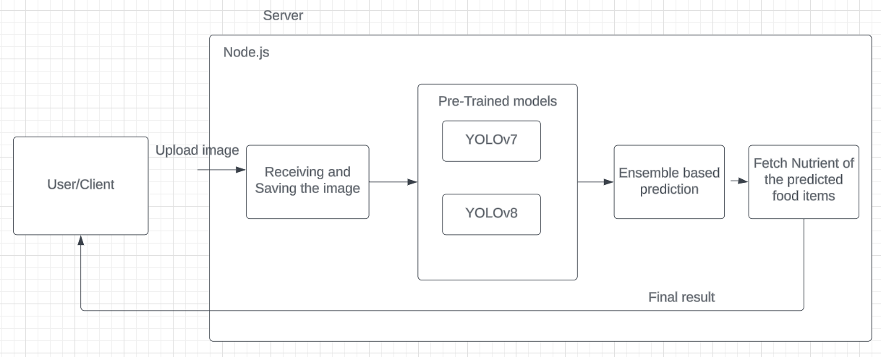
Workflow

Slide 11
Outcomes
 | YOLOv7 | YOLOv8
Training Accuracy | 92 | 97
Test Accuracy | 80(avg) | 85(avg)
11

Slide 12
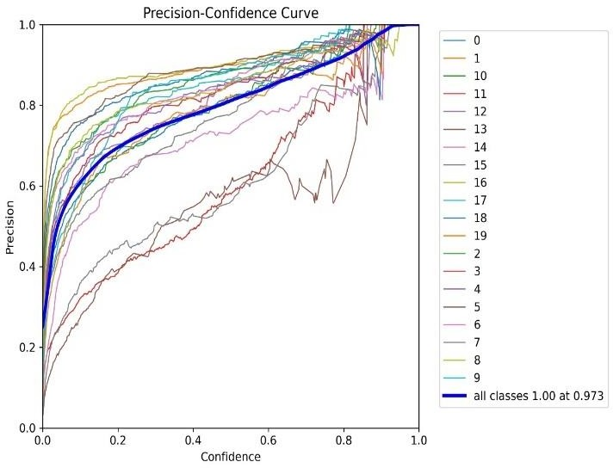
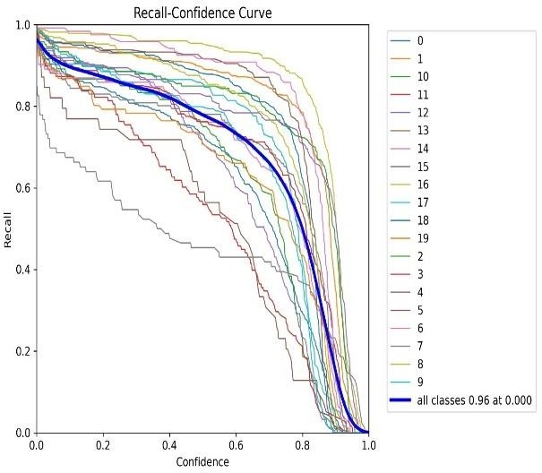
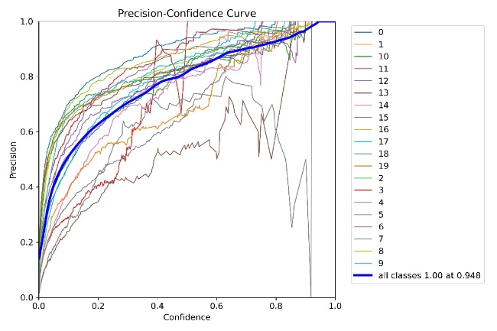
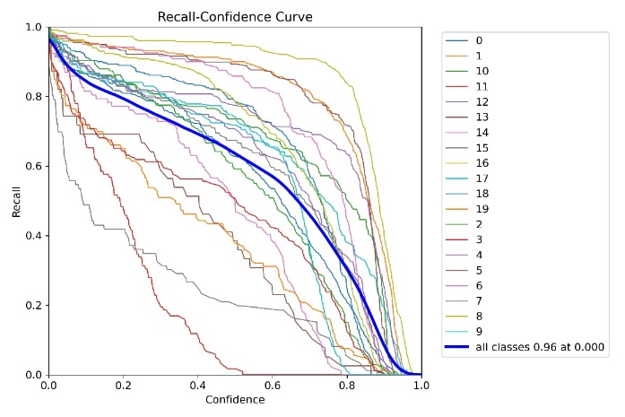
YOLOv8 Model Accuracy and Loss
YOLOv7 Model Accuracy and Loss

Slide 13
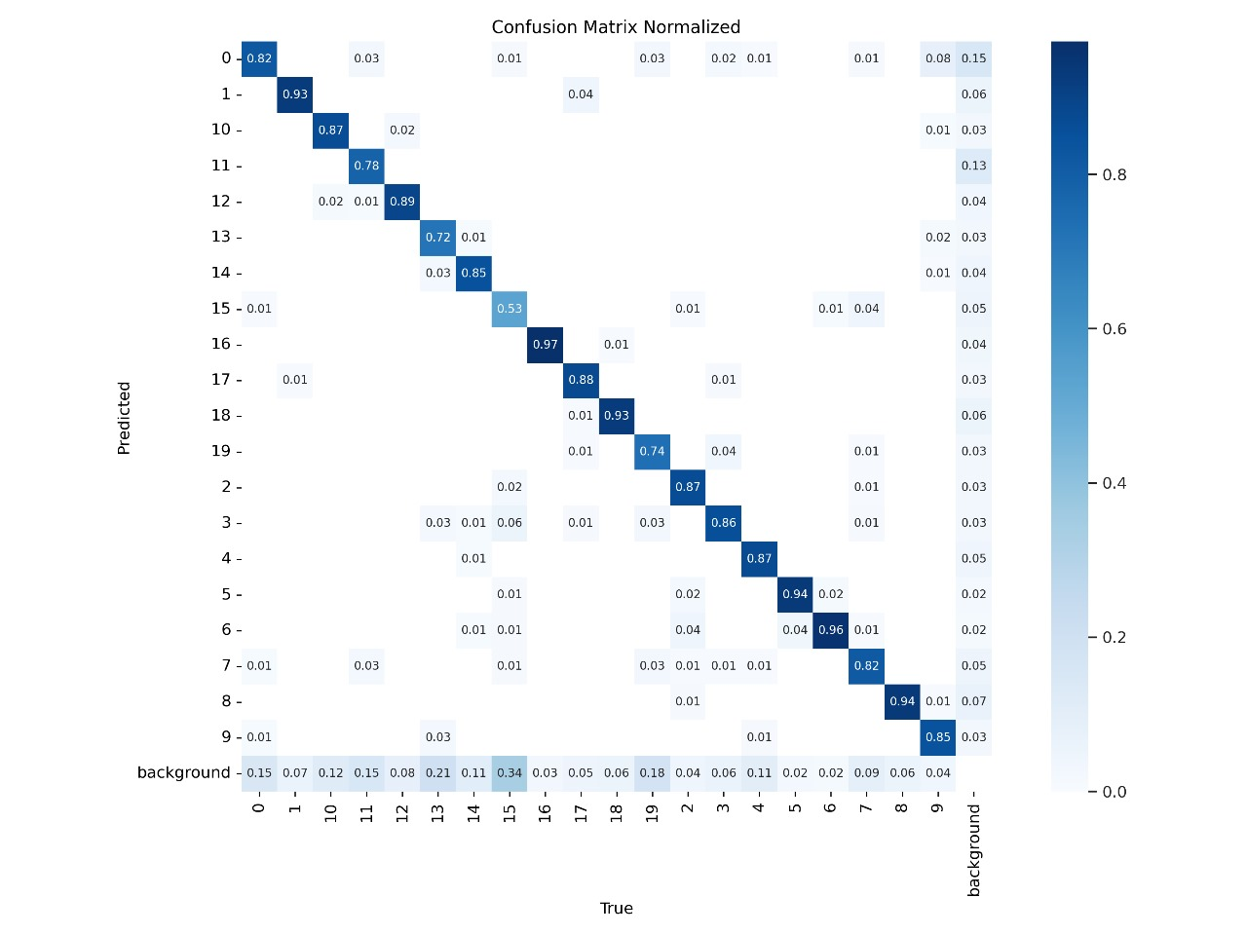

Slide 14
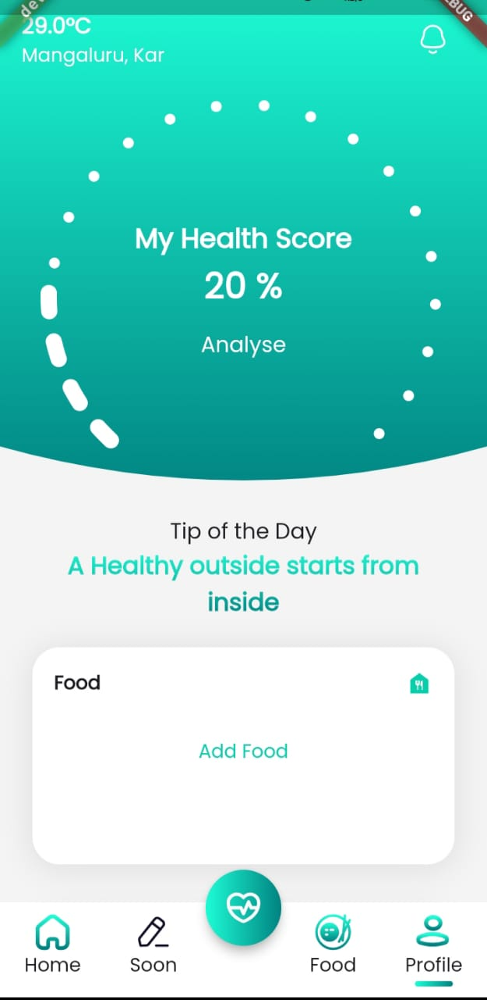
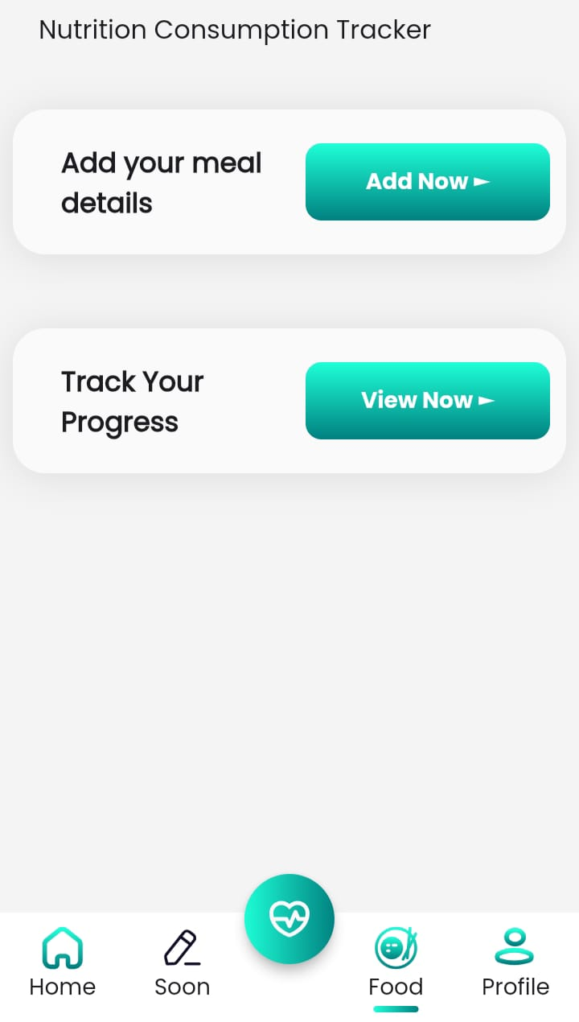

Slide 15
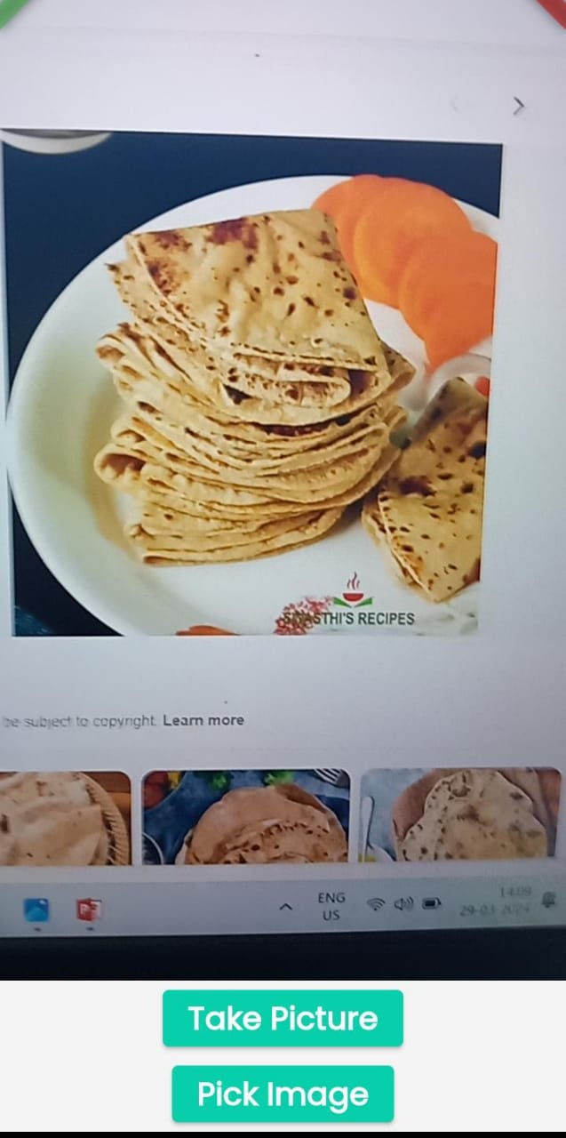
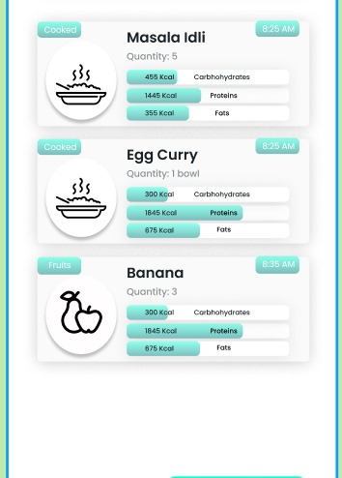

Slide 16
Future Scope and Enhancement
Further advancements in deep learning techniques, coupled with the availability of larger and more diverse datasets, are expected to continue improving the accuracy, robustness, and interpretability of deep learning CNN models for food classification.
In future we would like to add YOLOv9 along with these 2 models which would increase the prediction accuracy.

Slide 17
References
“Study for Food Recognition System Using Deep Learning”, Nareen O. M. Salim, Subhi R.M. Zeebaree, Mohammed A. M. Sadeeq, A. H. Radie, Hanan M. Shukur and Zryan Najat Rashid, Journal of Physics: Conference Series, Volume 1963, 2nd International Conference on Physics and Applied Sciences (ICPAS 2021), College of Education, Mustansiriyah University, Baghdad, Iraq, 26-27 MAY, 2021.
“Application of Machine Vision System in Food Detection”, Zhifei Xiao Jilai Wang* Lu Han* Shubiao Guo Qinghao Cui,Front. Nutr., 11 May 2022 Sec. Food Chemistry, Volume 9 - 2022 | https://doi.org/10.3389/fnut.2022.888245.
IndianFoodNet: Detecting Indian Food Items Using Deep Learning(2023) : Ritu Agarwal1* , Tanupriya Choudhury1,2,3 , Neelu J. Ahuja1 , Tanmay Sarkar4, School of Computer Science, University of Petroleum and Energy Studies (UPES), Dehradun 248007, India CSE Department, Graphic Era Deemed to be University, Dehradun 248002, Uttarakhand, India CSE Department, Symbiosis Institute of Technology, Symbiosis International (Deemed University), Pune 412115, India Department of Food Processing Technology, Malda Polytechnic, Bengal State Council of Technical Education, Malda 732102, India Corresponding Author Email: agarwalritu7@gmail.com.
https://doi.org/10.18280/ijcmem.110403.

Slide 18
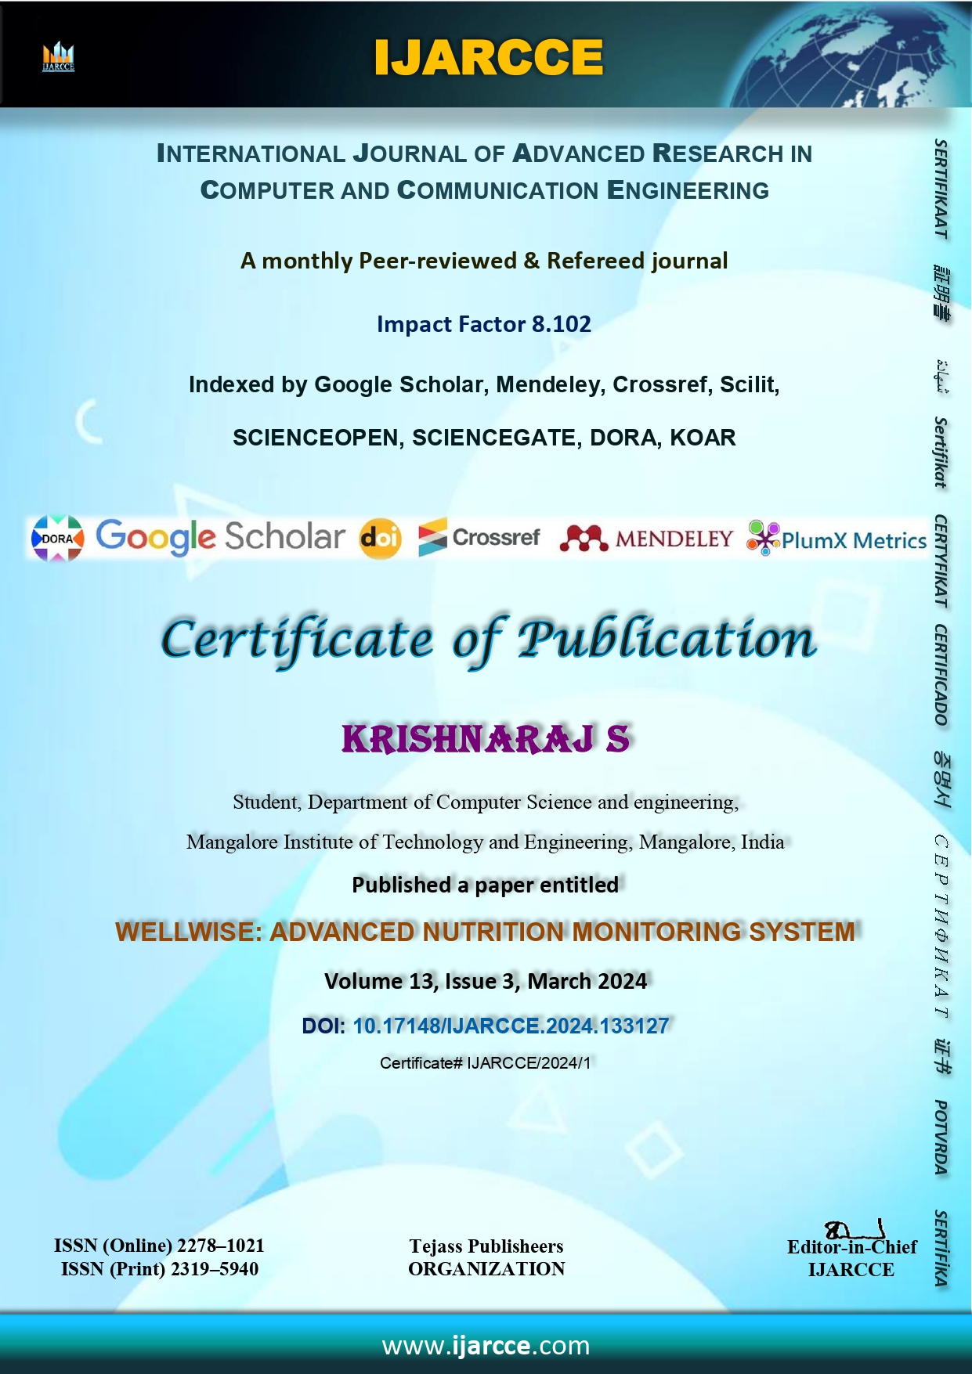

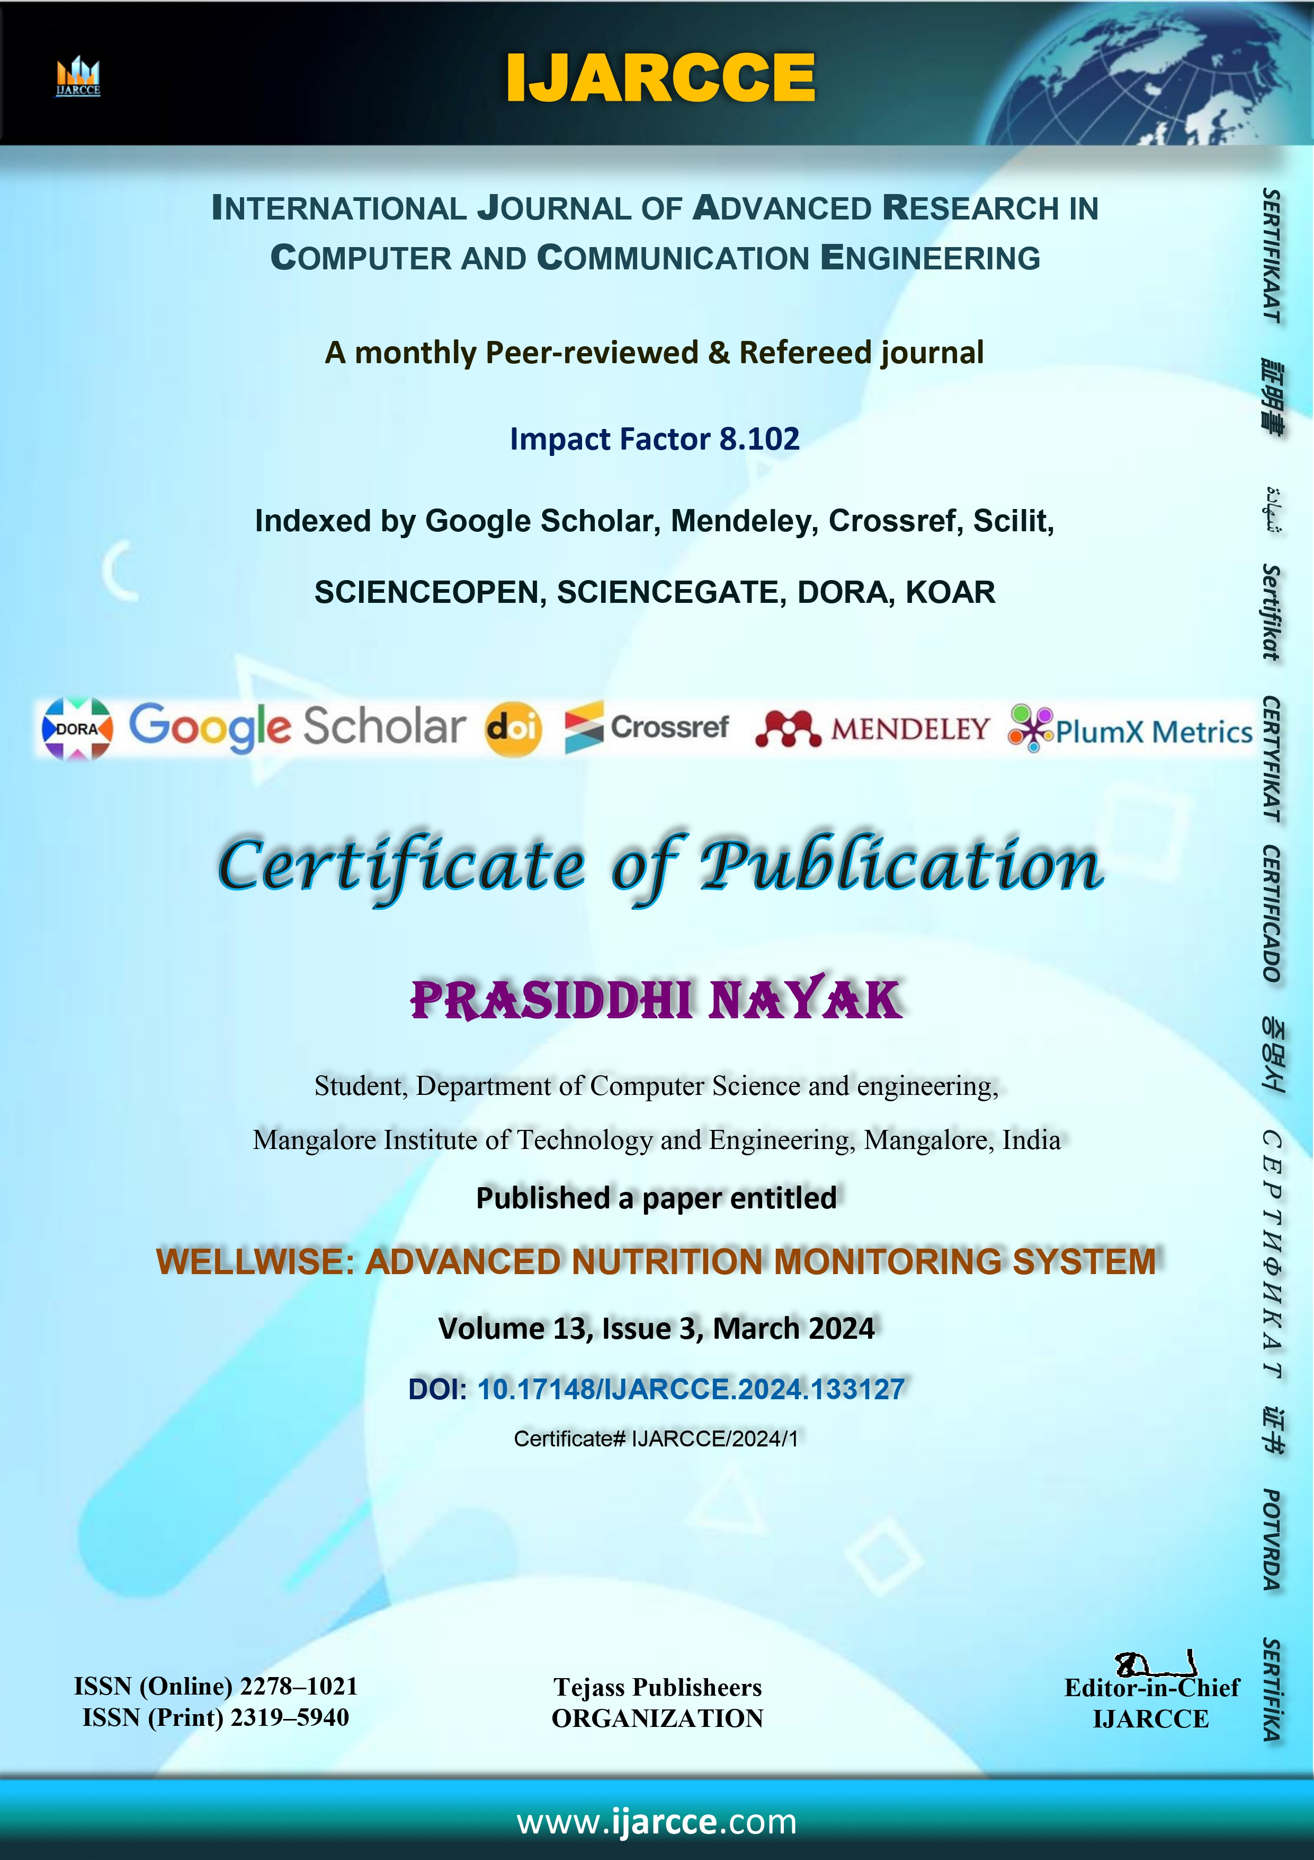
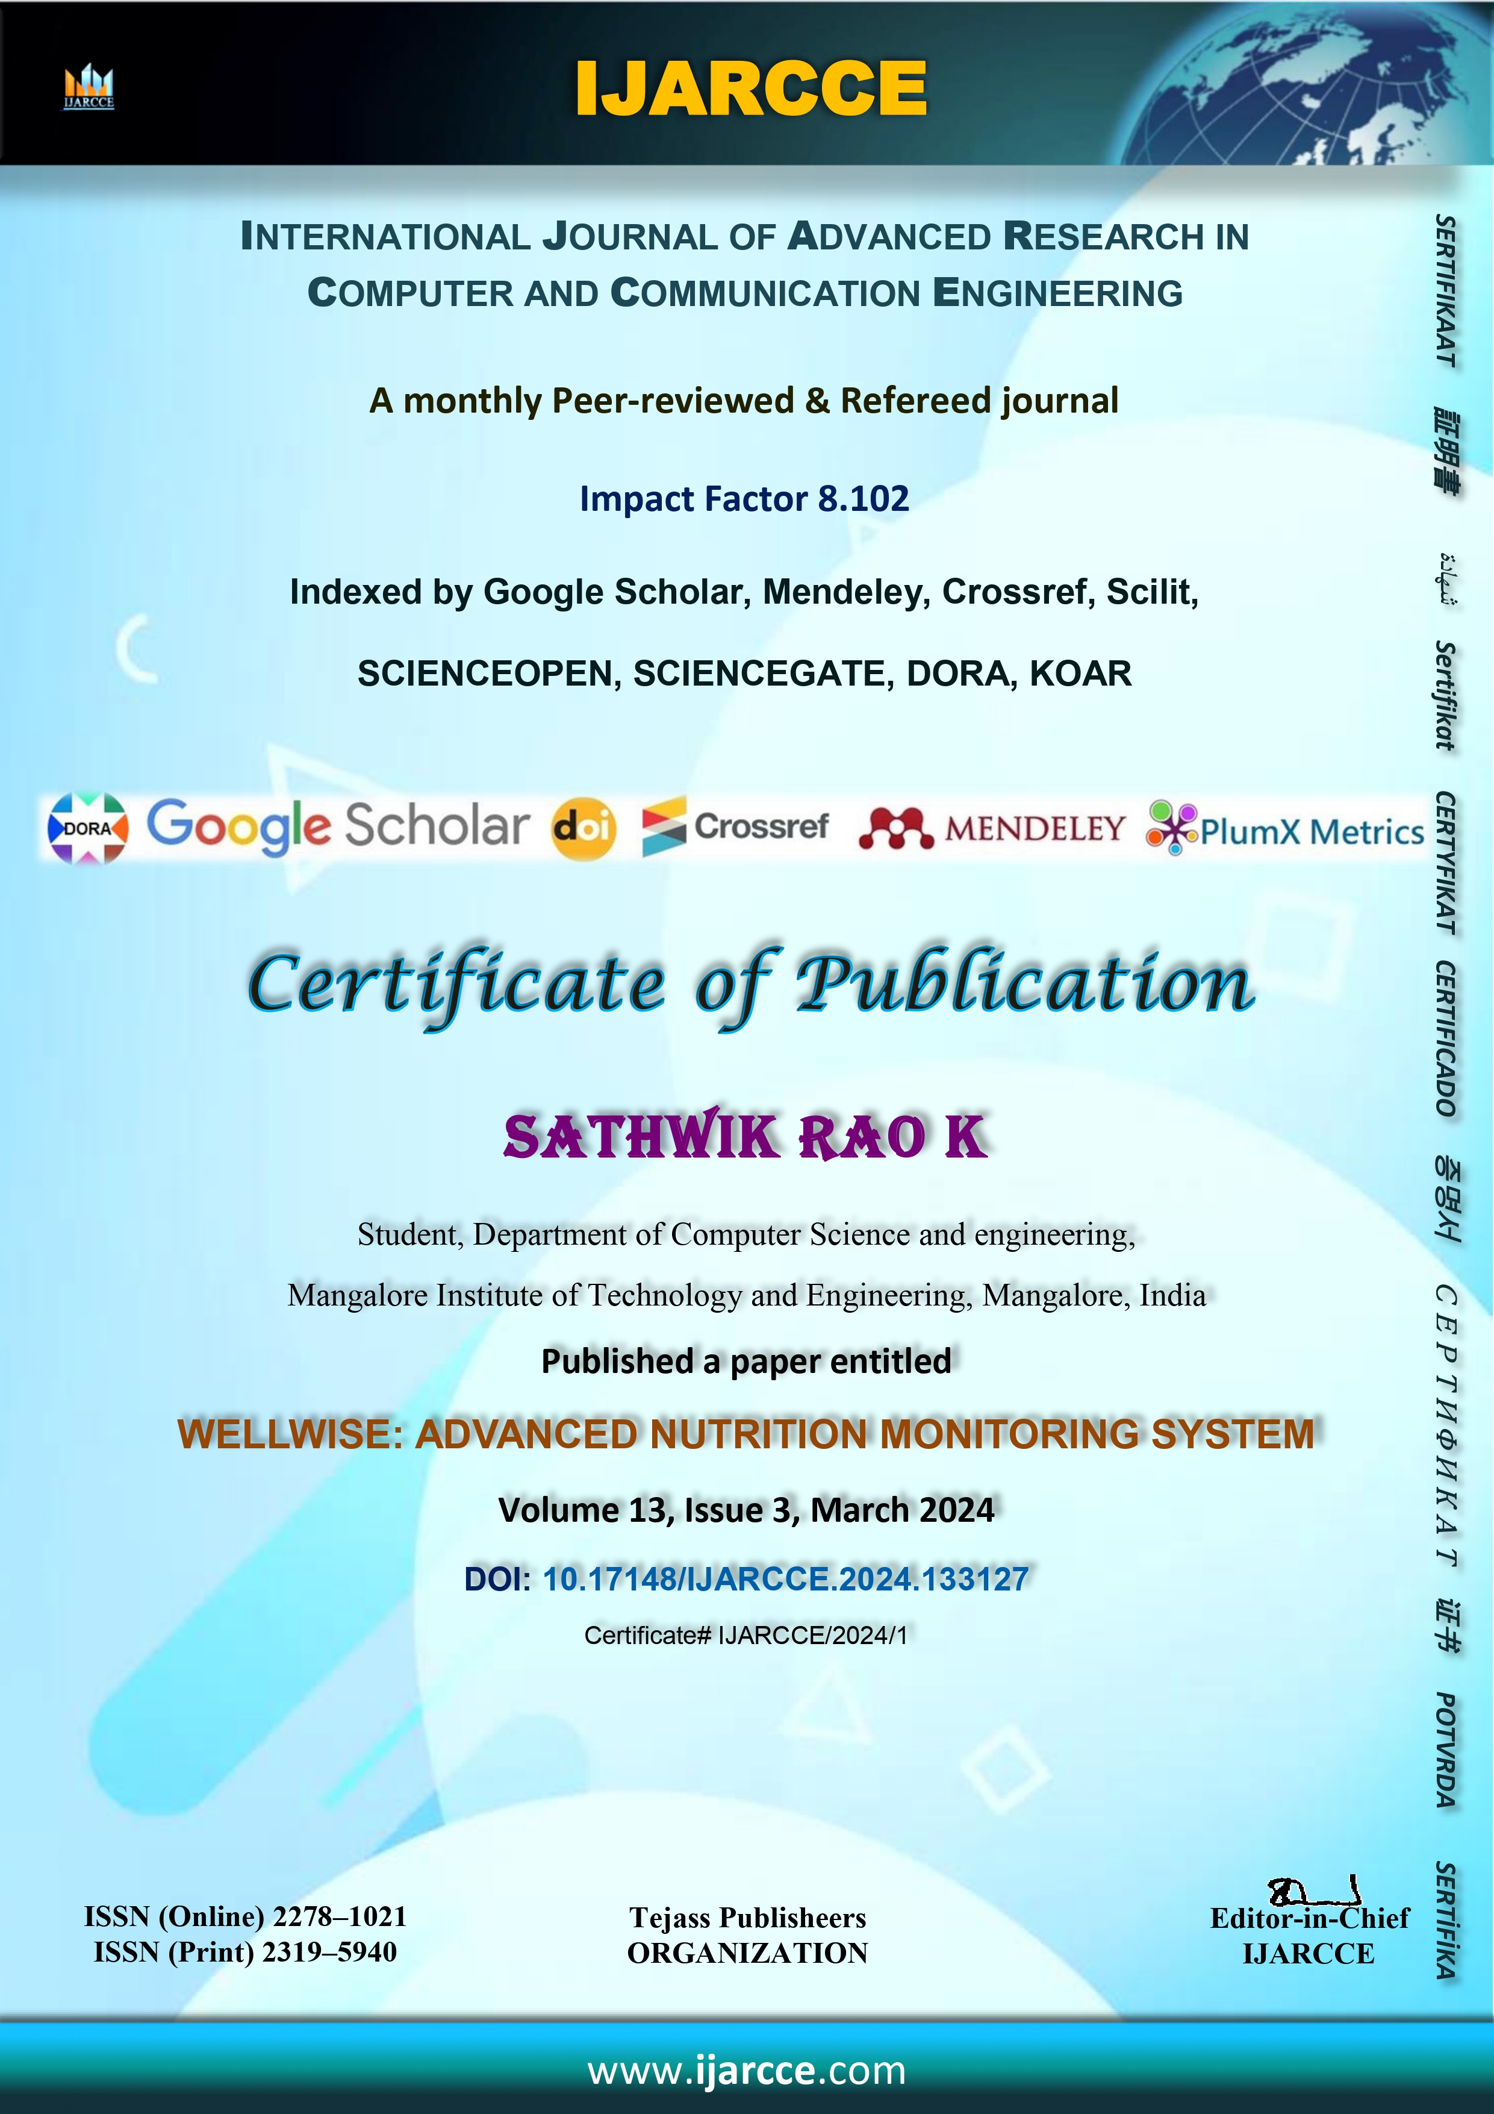

Slide 19
THANK YOU…!

